Slide 1
P513-Resume classification

Slide 2
GROUP MEMBERS
Neeraja B
Vaishnav P
SAJITHA A
Keerthi Mani Purna Chandrika
ASWANTH TK
Jithin K S
Sonam Akshay Sherkar

Slide 3
INSTALLING NECESSARY PACKAGES AND LIBRARIES 1. pandas: Handles structured data (CSV, Excel, etc.). Useful for loading, cleaning, and analyzing resume datasets. 2. seaborn: Statistical data visualization library. Built on Matplotlib and used to generate heatmaps, bar charts, and more. 3. nltk(Natural Language Toolkit):Used for text processing in NLP. Includes tools for tokenization, stopword removal, stemming, and lemmatization. 4. python-docx: Reads and processes Microsoft Word (.docx) files. Extracts text from resumes stored in DOCX format.

Slide 4
INSTALLING NECESSARY PACKAGES AND LIBRARIES 5. pymupdf: library for working with PDFs. It extracts text, images, and metadata efficiently. 6. wordcloud: Used to generate visual representations of frequently occurring words. Helps in understanding important keywords in resumes. 7. os: Interacts with the operating system (file handling, directory management). 8. win32com.client: Interacts with Microsoft Word to extract text from .doc files.

Slide 5
Extracting Data from Folders
We used the os module to navigate directories and fetch resumes.
It reads different resume formats (DOCX, PDF, etc.) using libraries like python-docx and pymupdf.
It loops through each file, extracts text, and stores it.

Slide 6
Creating raw_details.csv
The dataset contains 4 categories of resumes, and the script extracts text from all of them and combines them into a single CSV.
The extracted text is stored in two lists:
Raw_details: Stores resume content.
Category: Stores the category.
The script repeats this for other categories.
After collecting all resumes, the script creates a pandas DataFrame.
All DataFrames are combined using pd.concat() and saved it as raw_details.csv.

Slide 7
Cleaning the Data
The script applies text preprocessing:Removing special characters, numbers, extra spaces
Lowercasing the text
Removing stopwords (like "the", "is", "and")
Applying stemming or lemmatization to reduce words to base forms
This removes non-alphabetic characters and converts everything to lowercase.

Slide 8
Saving the Cleaned Data and creating Visualizations
The cleaned version of the dataset is stored in a new CSV file.
This is used for training models or further analysis.
Visualizations:
Pie chart: Used to show the percentage of resumes in each category.
Bar Plot: Used to show the count of resumes per category.
Word cloud: Shows frequent words in resumes

Slide 9
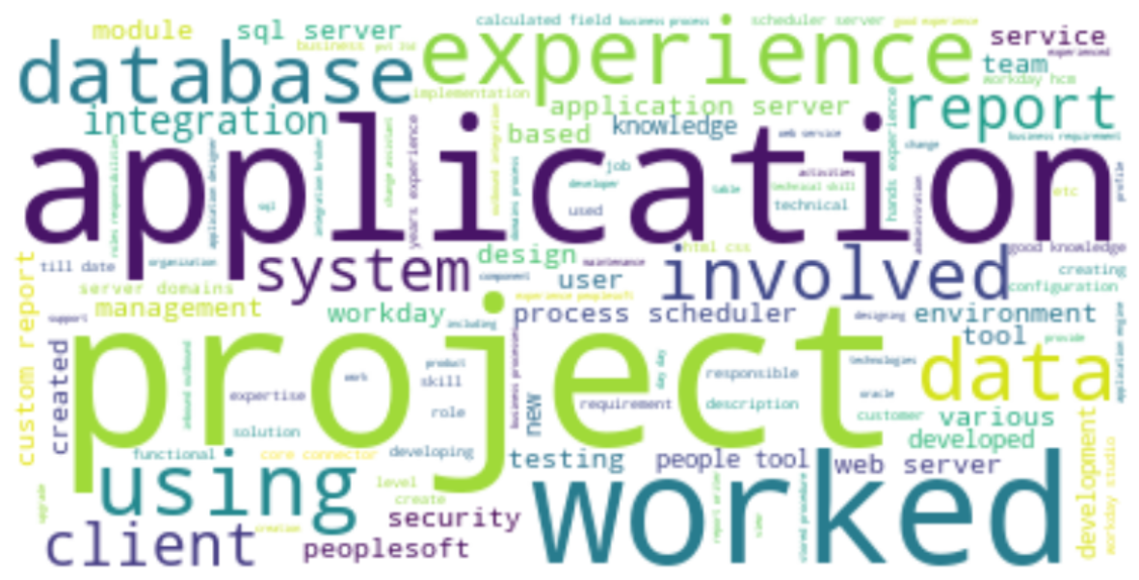
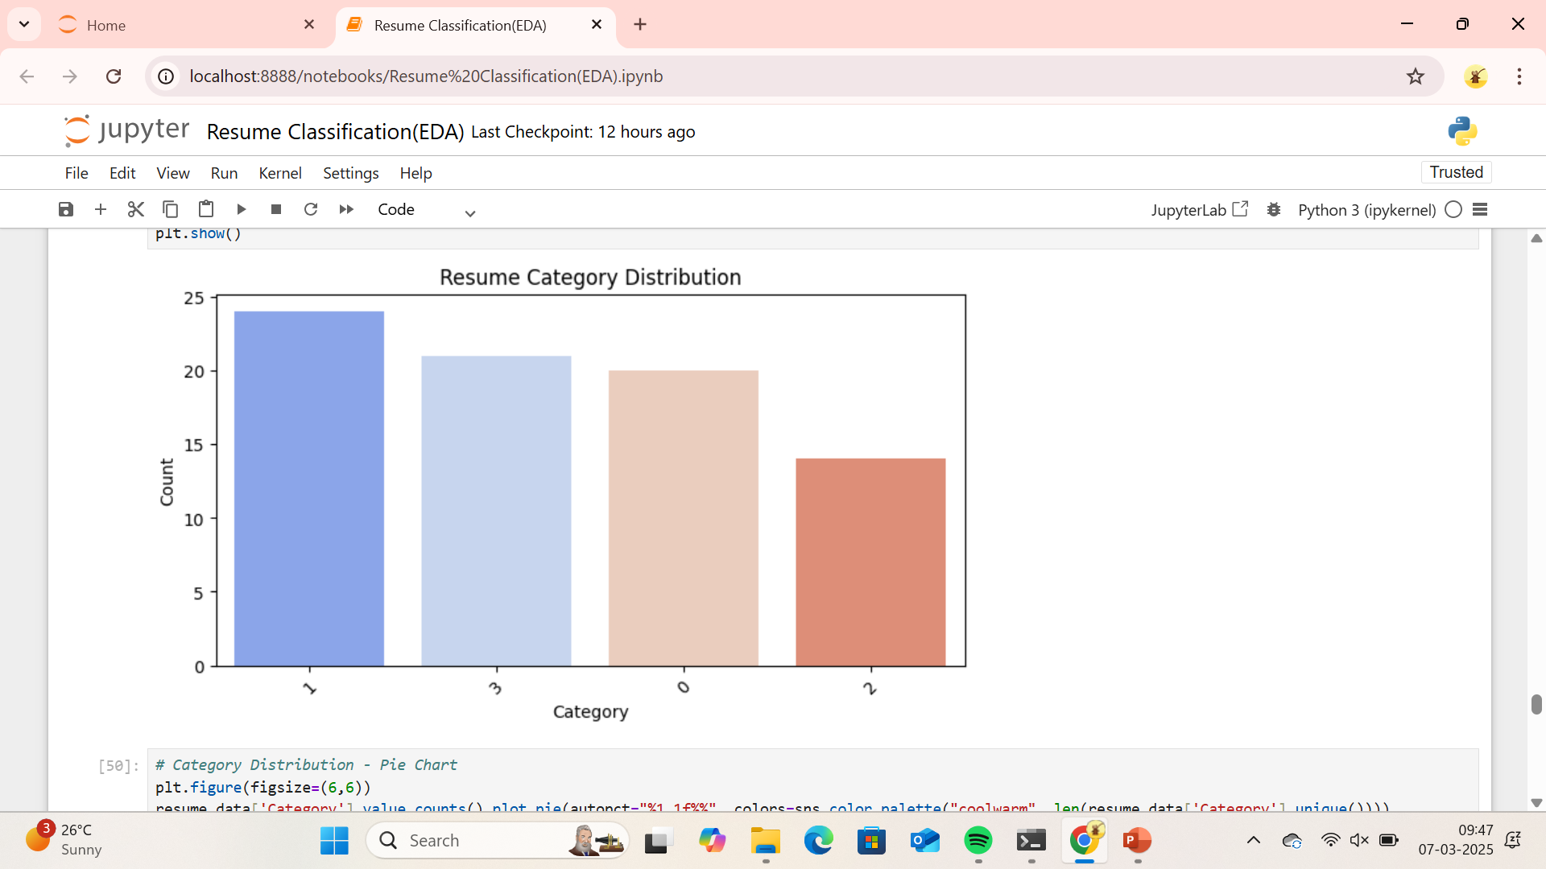
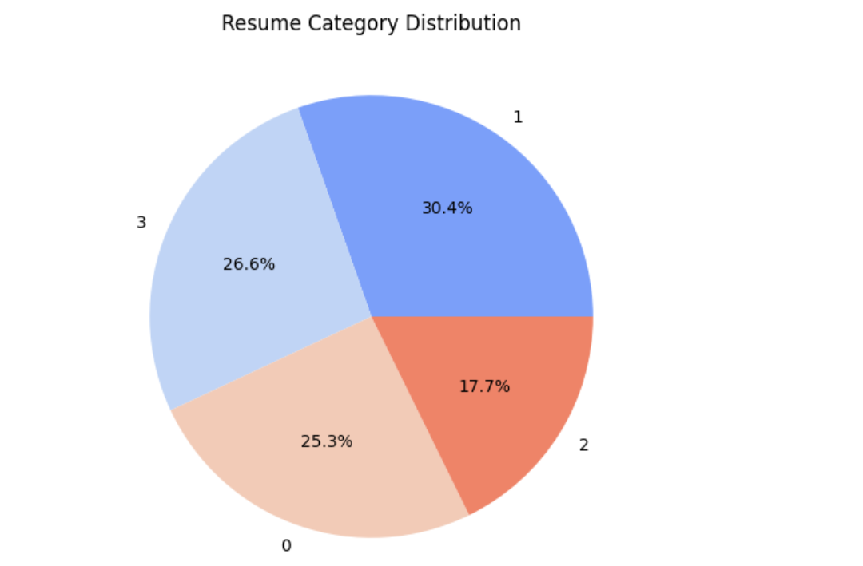
Visualizations

Slide 10
Thank you

